Slide 1
NBAC Annual Report Content Review

Slide 2
NBAC Annual Report Content
NIEM VISION AND PRIORITIES

Slide 3
DRAFT NIEM VISION
Advance the NIEM community-based standards approach to improve information exchanges among federal, state, local, tribal and international partners.
To elevate data as a strategic asset by advancing the NIEM community-based standards framework to improve data interoperability and support existing and emerging technologies among federal, state, local, tribal, industry and international partners.
To elevate data as a strategic asset by advancing the NIEM community-based standards framework to improve global data interoperability and support existing and emerging technologies.
To elevate data as a strategic asset by advancing the NIEM community-based standards framework to improve data interoperability and support existing and emerging technologies among national and international partners.
Notes:
This presentation is divided into seven modules.
In the first module, “What is NIEM,” I’ll discuss what NIEM is and how it works. I’ll also introduce NIEM’s data model and its data components.
In the second module, “How NIEM Got Started,” I’ll talk about NIEM’s history from its beginnings to today.
In the third module, “How NIEM Works,” I’ll present a short clip called NIEM Simplified, which will help show how NIEM helps organizations exchange information.
In the fourth module, I’ll introduce to whom NIEM is available to and who currently uses NIEM.
The fifth module discusses NIEM’s benefits, and the sixth module introduces NIEM’s governance structure.
The last module provides the necessary steps and resources to help people get started in NIEM adoption.

Slide 4
DRAFT NIEM VISION
Advance the NIEM community-based standards approach to improve information exchanges among federal, state, local, tribal and international partners.
Greatly improved data interoperability, through advancing the NIEM community-based standards framework, supporting data analytics, artificial intelligence, machine-readable data resources, and other existing and emerging technology.
Apply the NIEM community-based standards framework to improve global data interoperability and elevate data as a strategic asset for artificial intelligence-enabled decision making.
Notes:
This presentation is divided into seven modules.
In the first module, “What is NIEM,” I’ll discuss what NIEM is and how it works. I’ll also introduce NIEM’s data model and its data components.
In the second module, “How NIEM Got Started,” I’ll talk about NIEM’s history from its beginnings to today.
In the third module, “How NIEM Works,” I’ll present a short clip called NIEM Simplified, which will help show how NIEM helps organizations exchange information.
In the fourth module, I’ll introduce to whom NIEM is available to and who currently uses NIEM.
The fifth module discusses NIEM’s benefits, and the sixth module introduces NIEM’s governance structure.
The last module provides the necessary steps and resources to help people get started in NIEM adoption.

Slide 5
NIEM VISION AND PRIORITIES
NIEM Vision
Advance the NIEM community-based standards approach to improve information exchanges among federal, state, local, tribal and international partners.
2018 Strategic Priorities
Advance NIEM adoption
Support NIEM domain growth and collaboration
Improve the implementation of NIEM conformant information exchanges
Operational Priorities
NIEM 4.2 Minor Release
NIEM 5.0 Major Release
Notes:
This presentation is divided into seven modules.
In the first module, “What is NIEM,” I’ll discuss what NIEM is and how it works. I’ll also introduce NIEM’s data model and its data components.
In the second module, “How NIEM Got Started,” I’ll talk about NIEM’s history from its beginnings to today.
In the third module, “How NIEM Works,” I’ll present a short clip called NIEM Simplified, which will help show how NIEM helps organizations exchange information.
In the fourth module, I’ll introduce to whom NIEM is available to and who currently uses NIEM.
The fifth module discusses NIEM’s benefits, and the sixth module introduces NIEM’s governance structure.
The last module provides the necessary steps and resources to help people get started in NIEM adoption.

Slide 6
NIEM strategic PRIORITIES and goals (1/3)
Advance NIEM adoption
NIEM Strategic Communications Plan
DOD Joint Artificial Intelligence Center (JAIC)
National Association of State CIOs (NASCIO)
US Office of Management and Budget (OMB)
Open Data Act
Evidence-Based Policymaking Act
Multinational Information Sharing
Canada
North Atlantic Treaty Organization (NATO)
Notes:
This presentation is divided into seven modules.
In the first module, “What is NIEM,” I’ll discuss what NIEM is and how it works. I’ll also introduce NIEM’s data model and its data components.
In the second module, “How NIEM Got Started,” I’ll talk about NIEM’s history from its beginnings to today.
In the third module, “How NIEM Works,” I’ll present a short clip called NIEM Simplified, which will help show how NIEM helps organizations exchange information.
In the fourth module, I’ll introduce to whom NIEM is available to and who currently uses NIEM.
The fifth module discusses NIEM’s benefits, and the sixth module introduces NIEM’s governance structure.
The last module provides the necessary steps and resources to help people get started in NIEM adoption.

Slide 7
NIEM strategic PRIORITIES and goals (2/3)
Support NIEM domain growth and collaboration
Onboard Statistics Domain – US Census Bureau
Onboard Cyber Domain – DHS
Onboard Humanitarian Aid Domain – US Agency for International Development (USAID)
Onboard Housing Domain – US Department of Housing and Urban Development (HUD)
Reinvigorate dormant Domains
Domain outreach to non-participatory stakeholders
Extend Domain Best Practices to NIEM Community
Notes:
This presentation is divided into seven modules.
In the first module, “What is NIEM,” I’ll discuss what NIEM is and how it works. I’ll also introduce NIEM’s data model and its data components.
In the second module, “How NIEM Got Started,” I’ll talk about NIEM’s history from its beginnings to today.
In the third module, “How NIEM Works,” I’ll present a short clip called NIEM Simplified, which will help show how NIEM helps organizations exchange information.
In the fourth module, I’ll introduce to whom NIEM is available to and who currently uses NIEM.
The fifth module discusses NIEM’s benefits, and the sixth module introduces NIEM’s governance structure.
The last module provides the necessary steps and resources to help people get started in NIEM adoption.

Slide 8
NIEM strategic PRIORITIES and goals (3/3)
Improve the implementation of NIEM conformant information exchanges
Java Script Object Notation (JSON)
Authorized access to sensitive information
Public Health Information (PHI)
Controlled Unclassified Information (CUI)
Identity, Credential, and Access Management (ICAM)
Cybersecurity
Support and enable new technologies
Artificial Intelligence (AI), Machine Learning (ML)
Internet of Things (IoT)
Quantum Computing
Micro and Web Services
Notes:
This presentation is divided into seven modules.
In the first module, “What is NIEM,” I’ll discuss what NIEM is and how it works. I’ll also introduce NIEM’s data model and its data components.
In the second module, “How NIEM Got Started,” I’ll talk about NIEM’s history from its beginnings to today.
In the third module, “How NIEM Works,” I’ll present a short clip called NIEM Simplified, which will help show how NIEM helps organizations exchange information.
In the fourth module, I’ll introduce to whom NIEM is available to and who currently uses NIEM.
The fifth module discusses NIEM’s benefits, and the sixth module introduces NIEM’s governance structure.
The last module provides the necessary steps and resources to help people get started in NIEM adoption.

Slide 9
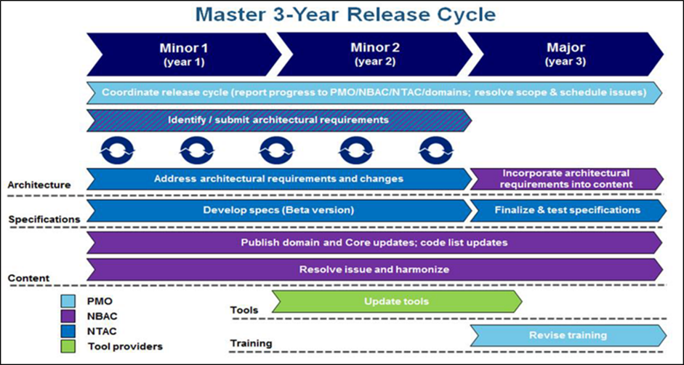
NIEM Operational Priorities
NIEM 4.2 Minor Release
NIEM 5.0 Major Release
Domain content harmonization
Architecture improvements
Specification updates
New Model content
Enhanced Tools
Training
Communications and Customer Relations
Notes:
This presentation is divided into seven modules.
In the first module, “What is NIEM,” I’ll discuss what NIEM is and how it works. I’ll also introduce NIEM’s data model and its data components.
In the second module, “How NIEM Got Started,” I’ll talk about NIEM’s history from its beginnings to today.
In the third module, “How NIEM Works,” I’ll present a short clip called NIEM Simplified, which will help show how NIEM helps organizations exchange information.
In the fourth module, I’ll introduce to whom NIEM is available to and who currently uses NIEM.
The fifth module discusses NIEM’s benefits, and the sixth module introduces NIEM’s governance structure.
The last module provides the necessary steps and resources to help people get started in NIEM adoption.

Slide 10
NIEM tools recommendations (1/2)
Provide the Community with an Enterprise Architecture Tool that documents their “as is” and “to-be” architectures and exchange models.
Integrate existing Movement and SSGT tools.
Focus on ease-of-use to encourage increased implementation by those who are on the fence.
NIEM could better position itself as a 'translator' of standards rather than as a standard itself, where it can be more easily dismissed as a competing or 'just another standard.‘
Consider alternate representations of NIEM to make it easier for tool developers to work within the NIEM framework.
Notes:
This presentation is divided into seven modules.
In the first module, “What is NIEM,” I’ll discuss what NIEM is and how it works. I’ll also introduce NIEM’s data model and its data components.
In the second module, “How NIEM Got Started,” I’ll talk about NIEM’s history from its beginnings to today.
In the third module, “How NIEM Works,” I’ll present a short clip called NIEM Simplified, which will help show how NIEM helps organizations exchange information.
In the fourth module, I’ll introduce to whom NIEM is available to and who currently uses NIEM.
The fifth module discusses NIEM’s benefits, and the sixth module introduces NIEM’s governance structure.
The last module provides the necessary steps and resources to help people get started in NIEM adoption.

Slide 11
NIEM tools recommendations (2/2)
End-to-end tool capability to facilitate and automate all phases of the NIEM IEPD Lifecycle (including tools to trace information exchange requirements from DODAF defined artifacts [scenario] and mapping ETL (mapping from a native model to NIEM).
Provide comprehensive NIEM JSON tool support.
Allow SSGT to restrict data type facets in subset schema generation. For example, string minimum Length or integer minimum Inclusive values.
Provide an easy browsing tool for NIEM core and Domain content.
Notes:
This presentation is divided into seven modules.
In the first module, “What is NIEM,” I’ll discuss what NIEM is and how it works. I’ll also introduce NIEM’s data model and its data components.
In the second module, “How NIEM Got Started,” I’ll talk about NIEM’s history from its beginnings to today.
In the third module, “How NIEM Works,” I’ll present a short clip called NIEM Simplified, which will help show how NIEM helps organizations exchange information.
In the fourth module, I’ll introduce to whom NIEM is available to and who currently uses NIEM.
The fifth module discusses NIEM’s benefits, and the sixth module introduces NIEM’s governance structure.
The last module provides the necessary steps and resources to help people get started in NIEM adoption.

Slide 12
NIEM Architecture recommendations
Create IEPD registry or repository.
Develop Privacy Sensitivity Marking and additional guidance on authorization for access to NIEM-exchanged data
Provision development and implementation environment that supports xml, json, mobile device exchanges and micro and web services.
Notes:
This presentation is divided into seven modules.
In the first module, “What is NIEM,” I’ll discuss what NIEM is and how it works. I’ll also introduce NIEM’s data model and its data components.
In the second module, “How NIEM Got Started,” I’ll talk about NIEM’s history from its beginnings to today.
In the third module, “How NIEM Works,” I’ll present a short clip called NIEM Simplified, which will help show how NIEM helps organizations exchange information.
In the fourth module, I’ll introduce to whom NIEM is available to and who currently uses NIEM.
The fifth module discusses NIEM’s benefits, and the sixth module introduces NIEM’s governance structure.
The last module provides the necessary steps and resources to help people get started in NIEM adoption.

Slide 13
NIEM outreach recommendations (1/2)
NIEM is unique in government and we need to better market ourselves to make the case.
Encourage health, education, housing, and other domains to join the health COI. It would be great to identify a health expert with the vision and gravitas to charter a proper domain, and understand how to message the fact that its purpose would be to translate between NIEM and existing health IT standards rather than compete with them.
Provide a NIEM Customer Relations Management (CRM) tool to improve Domain collaboration and awareness within and across federal, state, local, and international stakeholders.
Notes:
This presentation is divided into seven modules.
In the first module, “What is NIEM,” I’ll discuss what NIEM is and how it works. I’ll also introduce NIEM’s data model and its data components.
In the second module, “How NIEM Got Started,” I’ll talk about NIEM’s history from its beginnings to today.
In the third module, “How NIEM Works,” I’ll present a short clip called NIEM Simplified, which will help show how NIEM helps organizations exchange information.
In the fourth module, I’ll introduce to whom NIEM is available to and who currently uses NIEM.
The fifth module discusses NIEM’s benefits, and the sixth module introduces NIEM’s governance structure.
The last module provides the necessary steps and resources to help people get started in NIEM adoption.

Slide 14
NIEM Outreach recommendations (2/2)
Provide access to a library of topic based information (e.g., AI, IoT, Open Data, etc.) handouts to facilitate cross-community collaboration.
Develop and maintain an updated list of organizations using NIEM.
Notes:
This presentation is divided into seven modules.
In the first module, “What is NIEM,” I’ll discuss what NIEM is and how it works. I’ll also introduce NIEM’s data model and its data components.
In the second module, “How NIEM Got Started,” I’ll talk about NIEM’s history from its beginnings to today.
In the third module, “How NIEM Works,” I’ll present a short clip called NIEM Simplified, which will help show how NIEM helps organizations exchange information.
In the fourth module, I’ll introduce to whom NIEM is available to and who currently uses NIEM.
The fifth module discusses NIEM’s benefits, and the sixth module introduces NIEM’s governance structure.
The last module provides the necessary steps and resources to help people get started in NIEM adoption.

Slide 15
NIEM Training recommendations (1/2)
NIEM training seems to have been de-emphasized recently, and it's a shame. If the tooling had kept pace and there was no longer a need to understand extension schemas, augmentations, etc., that would be one thing, but implementers still need support. The GTRI training wiki is a huge help, but the training question should be revisited by the NMO/ESC at some point.
NIEM GitHub training is helpful, but doesn’t provide all the training as the old Power Point slide-based training.
Notes:
This presentation is divided into seven modules.
In the first module, “What is NIEM,” I’ll discuss what NIEM is and how it works. I’ll also introduce NIEM’s data model and its data components.
In the second module, “How NIEM Got Started,” I’ll talk about NIEM’s history from its beginnings to today.
In the third module, “How NIEM Works,” I’ll present a short clip called NIEM Simplified, which will help show how NIEM helps organizations exchange information.
In the fourth module, I’ll introduce to whom NIEM is available to and who currently uses NIEM.
The fifth module discusses NIEM’s benefits, and the sixth module introduces NIEM’s governance structure.
The last module provides the necessary steps and resources to help people get started in NIEM adoption.

Slide 16
NIEM Training recommendations (2/2)
Recommend specific training objectives be identified with associated curricula for adopters, modelers, developers, and users to achieve and demonstrate (test) an achieved level of NIEM proficiency.
Develop tool training to improve proficiency in the use of NIEM tools.
Notes:
This presentation is divided into seven modules.
In the first module, “What is NIEM,” I’ll discuss what NIEM is and how it works. I’ll also introduce NIEM’s data model and its data components.
In the second module, “How NIEM Got Started,” I’ll talk about NIEM’s history from its beginnings to today.
In the third module, “How NIEM Works,” I’ll present a short clip called NIEM Simplified, which will help show how NIEM helps organizations exchange information.
In the fourth module, I’ll introduce to whom NIEM is available to and who currently uses NIEM.
The fifth module discusses NIEM’s benefits, and the sixth module introduces NIEM’s governance structure.
The last module provides the necessary steps and resources to help people get started in NIEM adoption.

Slide 17
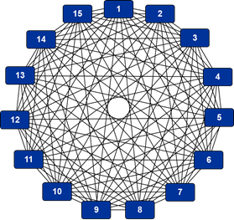
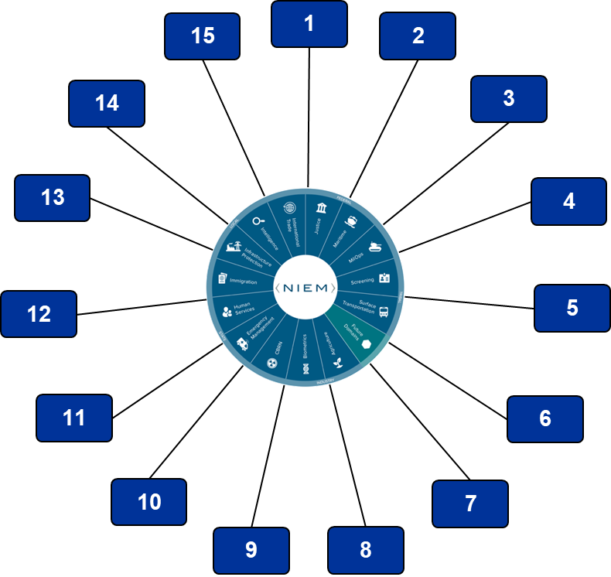
The NIEM value proposition
When using NIEM, you only need to “speak” two languages—your own and NIEM.
I say “vessel,” you say “boat,” and she says “conveyance.” We mean the same thing, but we have no way to tell our computer systems to treat the words as having the same meaning. NIEM lets your system and my system speak to and understand each other, even if they’ve never spoken before. NIEM ensures that information carries the same consistent meaning, allowing interoperability.
Vs.
15 systems
210 interface mappings
Total level of effort is O(210)
15 systems
15 interface mappings
Total level of effort is O(15)

